Slide 1
Agenda
Welcome
NPO
Teamspeak
Projects
Technical
Finance
Open floor
Raffle
Closing

Slide 2
CTWUG Financial update
21 May – 23 August 2018

Slide 3
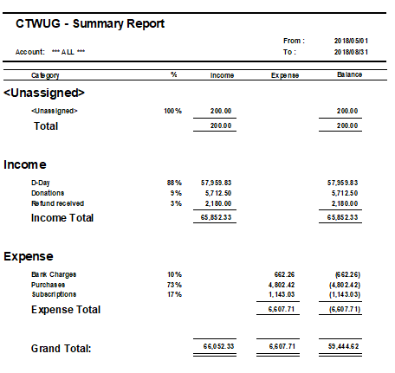
The bank account at a glance

Slide 4
Current status
Balance as of 2018/08/23 | R136 774.20
Cash expenditure this quarter | R6 607.00
Cash income this quarter | R 65 852.33
R 136 774,20
R 6 607
R 65 852.33

Slide 5
Monthly expenses
(average per month – 2018/05/21–2018/08/23)
Bank charges : R220,75
VPSdime : R 108,99 (per VM, total of 4 units)

Slide 6
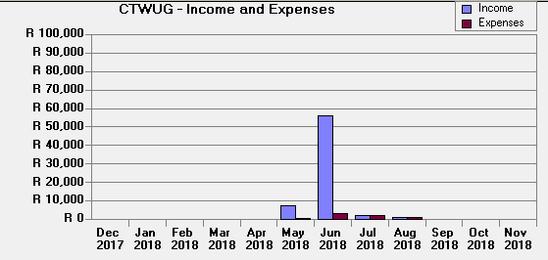
Activity for the year
(2018/05/21-2018/08/23)

Slide 7
Agenda
Welcome
NPO
Teamspeak
Projects
Technical
Finance
Open floor
Raffle
Closing

